Slide 1
Does the Quality of the Judiciary Shape Economic Activity? Evidence from India.
Matthieu Chemin† Department of Economics, LSE
Presented by Yunfei Ni

Slide 2
1 Introduction
Standard neoclassical economics: judiciary is perfect, fair, immediate.
There always exists a set of prices such that contracting can achieve Pareto efficiency.
Not clear from a theoretical standpoint why the quality of the judiciary impacts on the economy.
An efficient judicial system is still a rarity in the developing world.

Slide 3
recent papers suggest institutions may exert a fundamental impact on the contracting behavior of firms and hence on aggregate economic performance.

Slide 4
To date, the literature on the links between institutions, contract enforcement and economic performance has been largely macroeconomic.
The author tries to explain this link from a micro view– the speed of judiciary

Slide 5
2 Theory
Proposition 1: The number of breaches of contract increases as the quality of the judiciary decreases.
Proposition 2: relationship-specific investments become less attractive as the quality of the judiciary decreases.
Proposition 3: if the judiciary gets worse, the bank charges higher interest and less people cooperate with the bank
Proposition 4 There must be more family-owned firms in states with a worse judiciary.

Slide 6
To summarize:
in states with a worse judicial system, there are more breaches of contract, less relationship-specific investments, more difficulty accessing credit market, and more family firms.

Slide 7
Methods and Results
In this specification, determinants of the outcome include a constant (α0),
the pendency percentage (ps),
a vector of state-level controls(Zs),
a vector of firm-level controls (Xijs)
sector-fixed effects (dj).
The coefficient of interest is therefore β.

Slide 8
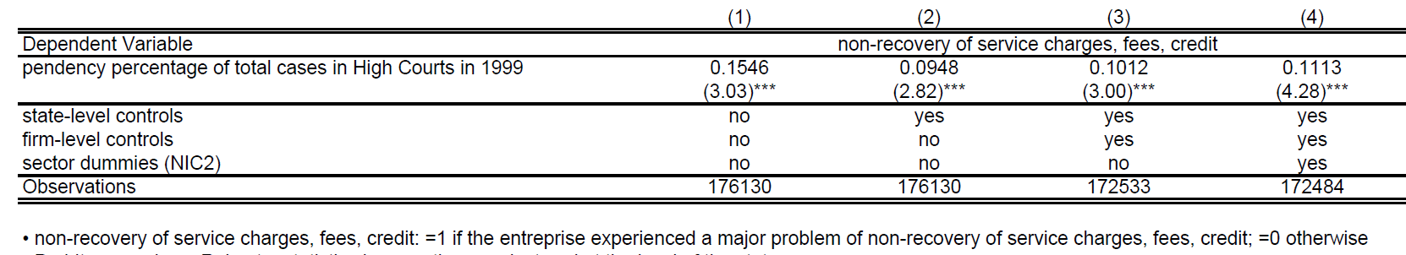
Table 1: The impact of pendency on the occurrence of breach of contract
In 1999, the pendency percentage varied across states between 45% and
90%. interpretation of the coefficient β:
the probability that the average firm in the average state will experience a breach of contract is 5 percentage points higher if the pendency percentage varies from the lowest rate to the highest rate in India.
(90%-45%)*0.1113

Slide 9
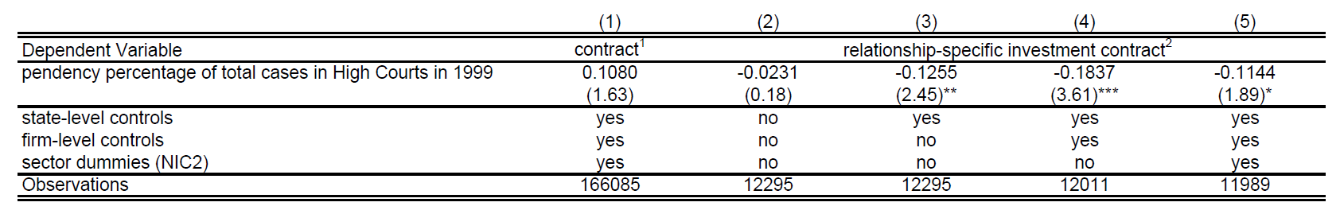
Table 2: The impact of pendency on the probability of working on a contract basis
the average firm in the average state is 4 percentage points less likely to undertake a relationship-specific investment if the judiciary is the slowest of India as opposed to the fastest.

Slide 10
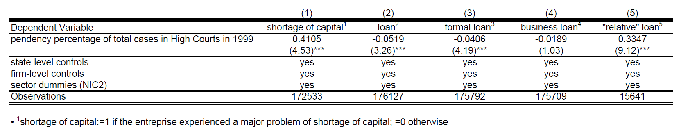
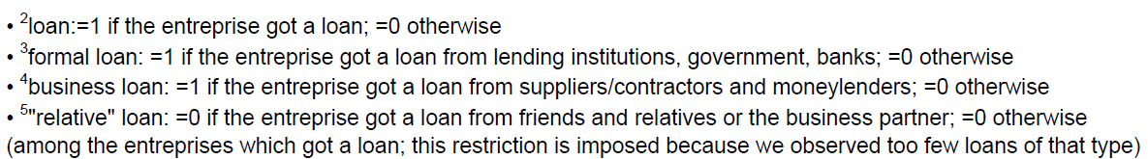
Table 3: The impact of pendency on shortage of capital
The average firm in the average state will find it 3.5 percentage points harder to get a loan with the slowest judiciary in India, relative to the fastest.

Slide 11
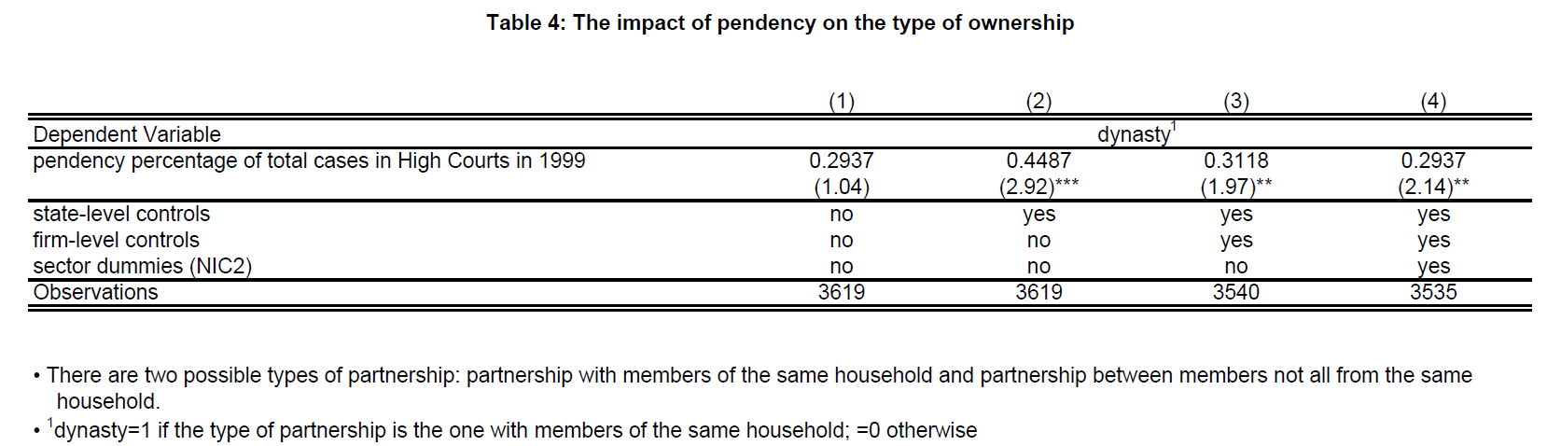
Column (4) illustrates that there are more partnerships with members of the same household in states with a slow judiciary. The average firm engaged in a partnership in the average state is 9 percentage points more likely to be a family firm if the judiciary is the slowest of India as compared to the fastest.

Slide 12


Robustness checks
1) possibility of out of court settlements
2) agents could self-select
So, a low pendency rate would not be evidence of an efficient judiciary.
Remedies: 1) Using instead of
2)Add the number of panchayats per capita and the number of rural planning commissions per capita.

Slide 13
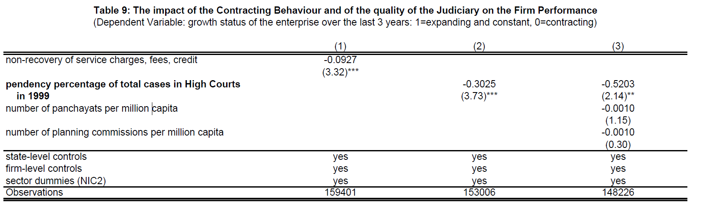
Effects on Firm Performance

Slide 14
Conclusion
firm owners in slow judiciary environments are more likely to break contracts, less likely to engage in relationship-specific investment, more likely to be credit constrained, less likely to have access to formal credit and more likely to keep the firm under family ownership.

Slide 15
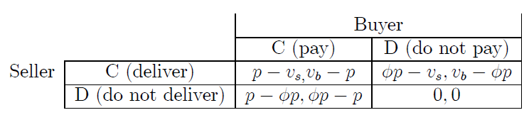
Appendix Prop. 1
A game theory model: a good is traded.
Vs: value to the seller Vb: value to the buyer
P: price φ:a measure of the speed of the judicial system
In the event of a default, the agent can sue his partner and regain a fraction φ of the price p of the good

Slide 16
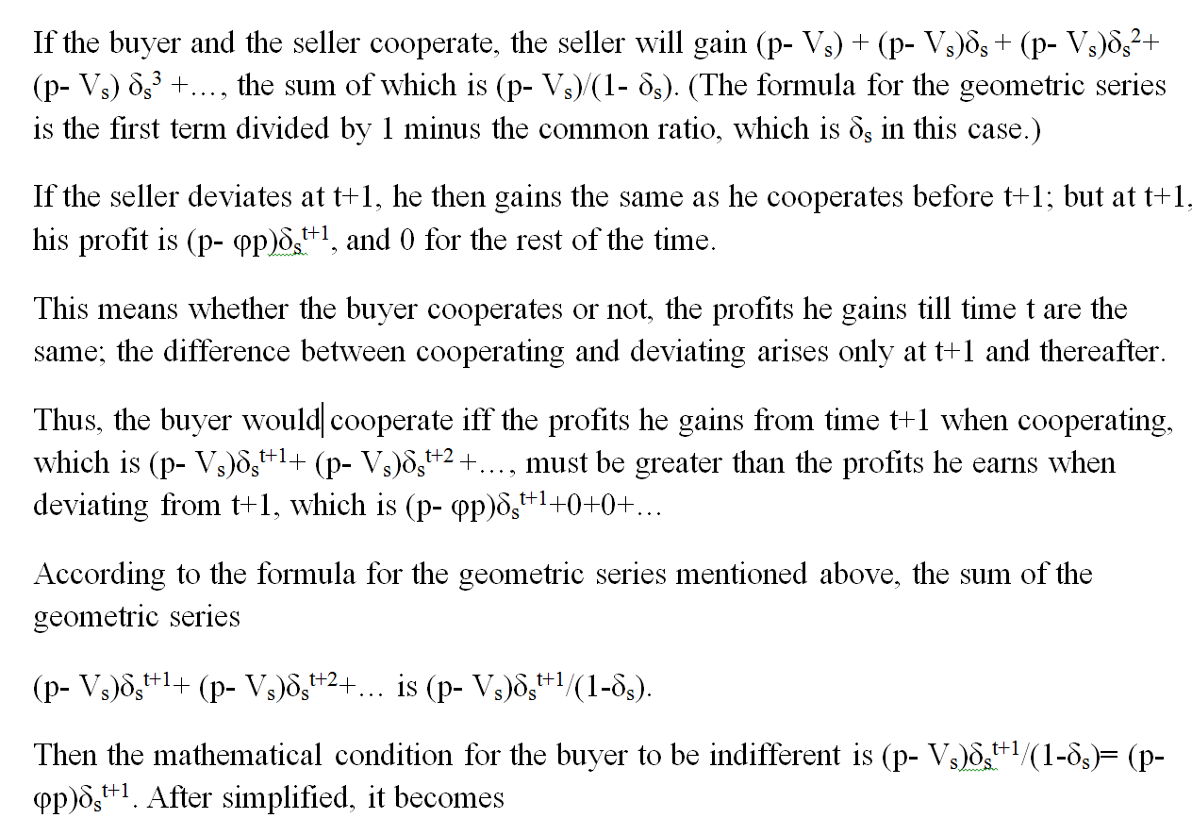

Slide 17
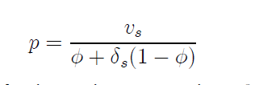

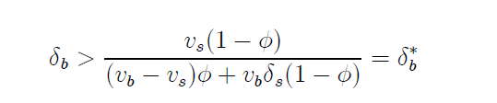
Results
Game with imperfect information:
IC seller
IC buyer
Plug in:
It is easy to check that the threshold δ*b is a decreasing function of φ.

Slide 18
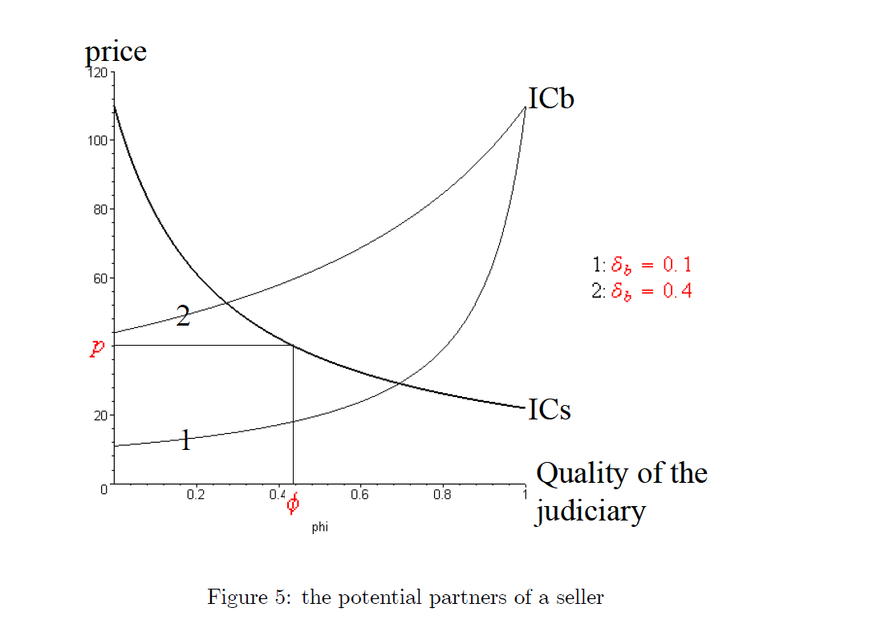

Slide 19
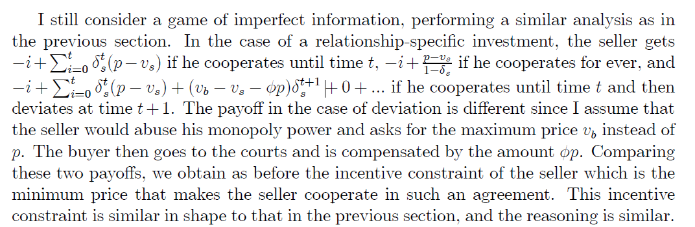
Prop. 2

Slide 20
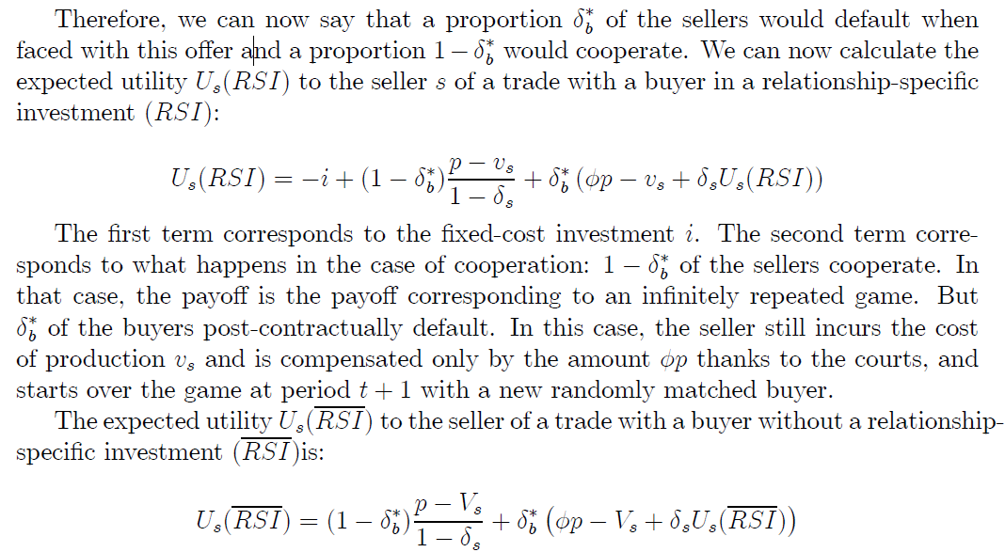
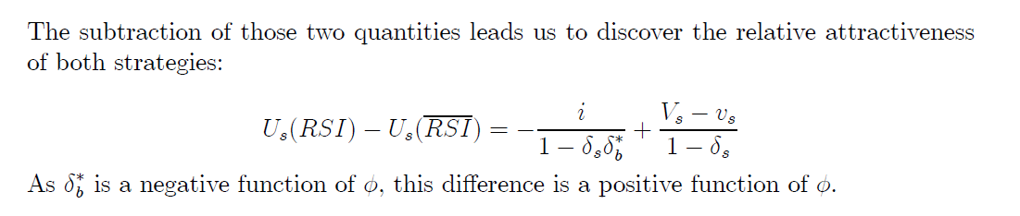

Slide 21
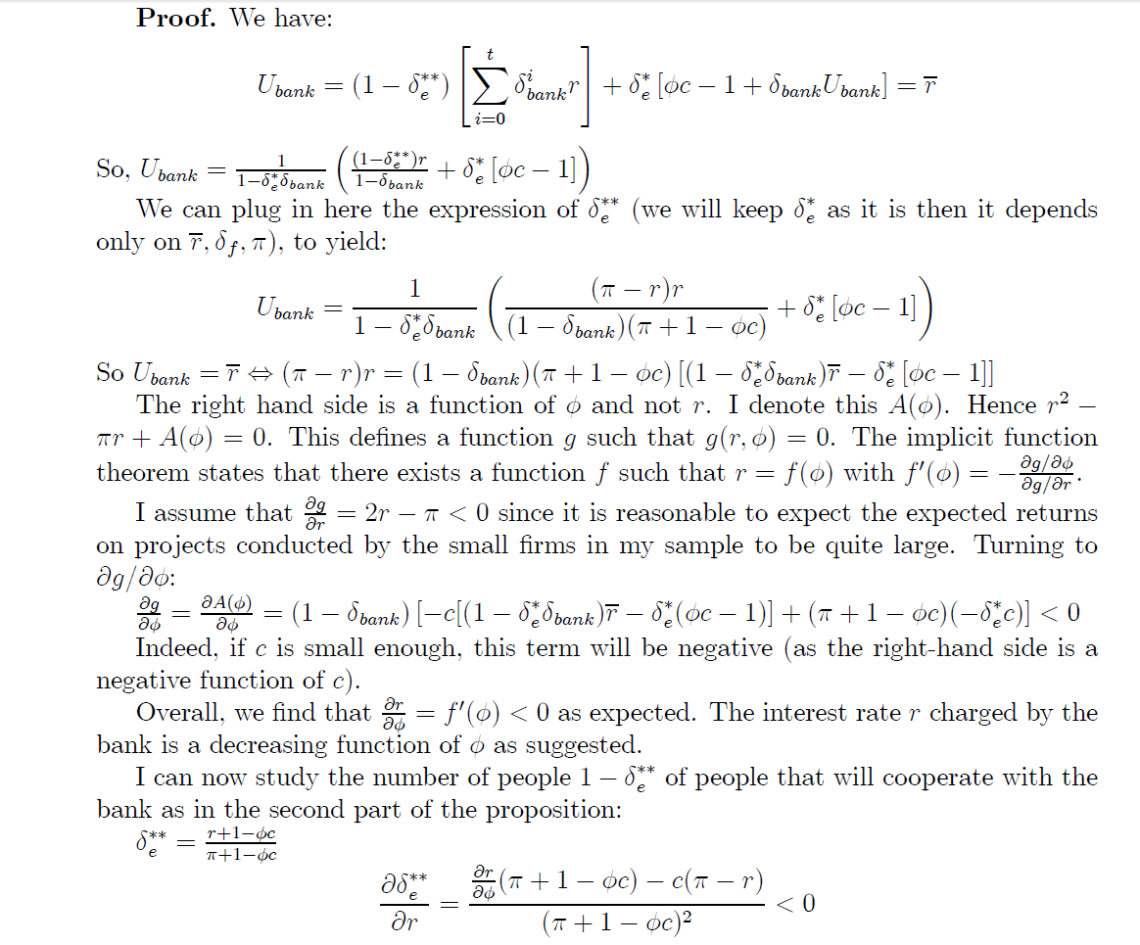
Prop. 3

Slide 22
